Slide 1
Sales Performance Broken Down By Country
The chart to the left includes four years of sales transactions that give us a look at the overall performance of each country.
Our North American market outperforms in total sales and units sold.

Slide 2
High Volume Countries
We used this chart to isolate the countries that sell more than the average units sold.
Looking past North America, we can see that France and Brazil are the closes to 200 units, it would be good to put more research into those markets to determine ways to increase sales.

Slide 3
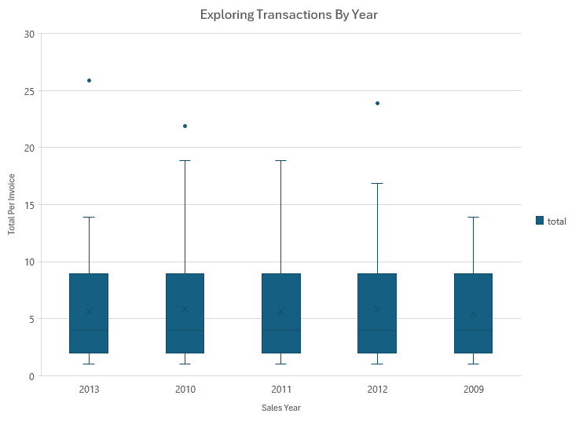
Ranking Sales By Year
When exploring transactions by year, we see that our average stays between $5 - $6.
With respect to outliers, we are seeing a consistent decrease in maximum transactions.

Slide 4
Genre Sales Performance
Most of the genres are low performing when looking at total sales for each individual genre.
Highest selling genres:
Rock at
Latin
Metal
Alternative & Punk
Highest Purchases | Genre sales total higher than $100 | 220
Mid-level Purchases | Genre sales total higher than $30 | 129
Low Purchases | Genre sales total less than $30 | 91

